Slide 1

Department of Medicine

Slide 2
Introduction
Is a chronic, lifelong disease
There is NO CURE for most
Patient compliance is important → early education
Care based on self-management
Patient must understand risks of diabetes & potential benefits of good glycaemic control
Misinformation from friends & other patients !!

Slide 3
Aims of Treatment
Freedom from symptoms & complications of hyperglycaemia
Freedom from hypoglycaemia
Minimal disruption of life style
Minimal psychological distress

Slide 4
Rationale of Treatment
Hyperglycaemia - main reason for developing microvascular complications
↓ of hyperglycaemia → mainstay of treatment
Macrovascular complications more dependent on non-glycaemic parameters
eg - BP, obesity, lipids

Slide 5
Management of DM
Diet
Lifestyle modification
Drugs
Insulin

Slide 6
Dietary Management - Objectives
1. Provide essential nutrients
2. Adopt to metabolic problems
eg – Type 1 → balance food, insulin and exercise
Type 2 → reduce weight
3. Prevent cardiovascular complications

Slide 7
Diet - General Recommendations
low in sugar
high in starchy carbohydrate (low GI)
high in fibre
low in fat
If overweight / obese → lose weight by reducing food intake & increasing physical activity

Slide 8
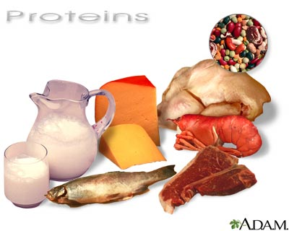
Protein
1 g/kg/day
10-20% of energy intake
Should not be less than 0.6g/kg/d

Slide 9
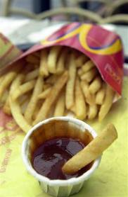
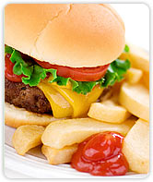
Fat
< 35% of total energy intake (TEI)
Limit - fat/oil in cooking
fried foods
processed meats
high-fat snacks
Encourage - lower-fat dairy products
lean meat

Slide 10
Fat
Eat fish 1-2/week (Fish oil supplements not recommended)
Cis-monounsaturated fat 10-20% of TEI
Dietary cholesterol 300 mg/d
Saturated and trans-unsaturated fat < 10% of TEI
Polyunsaturated fat < 10% of TEI

Slide 11
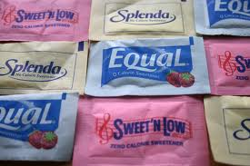
Carbohydrates
40-60% of TEI
Encourage - artificial sweeteners instead of sugar
Limit - fruit juices, confectionery, cake, biscuits
Sucrose up to 10% of TEI

Slide 12
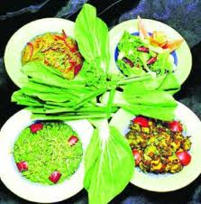

Carbohydrates
Fibre - no absolute quantity recommended
Soluble → beneficial in glycaemic and lipid metabolism
Insoluble → satiety & GI health
Foods with low glycaemic index - slower absorption
Cut refined sugars

Slide 13
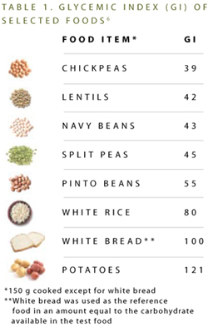

Slide 14
Other
Vitamins and antioxidants
Best taken as fruit and vegetables
5 portions per day
No evidence for use of supplements
Alcohol
Not forbidden
Energy content
May cause delayed hypoglycaemia in those on Insulin
Salt
<6 g per day
Lower in hypertension

Slide 15
Prescribing a Diet
Repeated advice & encouragement
Diet history
Minimum interference with patient’s lifestyle
Diet sheets, Dietician
If on Insulin or oral agents - eat roughly the same amount of food (esp carbs) at roughly the same time each day
Regular blood glucose monitoring – DAFNE (Dose Adjustment For Normal Eating) regimen

Slide 16


Exercise
Lowest long-term morbidity & mortality in patients with highest levels of CR fitness
Aerobic & resistance training improve insulin sensitivity and metabolic control in Type 1 & Type 2 DM
If on Insulin or Sulfonylureas - increased risk of hypoglycaemia for up to 6-12 hours following heavy exertion

Slide 17
Oral Hypoglycaemic Therapy
Diet + lifestyle changes = successful treatment of Type 2 DM
OHG if satisfactory metabolic control is not established within 4-6 weeks
Options - metformin
sulfonylurea
thiazolidinedione
meglitinides
DPP4 inhibitors

Slide 18
Biguanide (Metformin)
Best validated primary Rx for Type 2 DM
↓ gluconeogenesis - ↓ hepatic glucose output
↑ insulin sensitivity
Does NOT cause hypoglycaemia or weight gain
Can combine with sulfonylureas/ other OHGs

Slide 19
Biguanide (Metformin)
↓ microvascular complications
Only OHG giving cardiovascular protection
SEs - anorexia, epigastric discomfort, diarrhoea
less with slow-release preparations
Lactic acidosis if severe hepatic or renal disease - contraindicated
STOP when eGFR is <30ml/

Slide 20
Sulfonylureas
Promote insulin secretion by beta cells
Good for short-term (1-3 years) glucose control
Effect wears off as beta-cell mass ↓
Promote weight gain – avoid in overweight / obese
Can cause hypoglycaemia – usually mild
Caution in liver disease
Renal impairment – give drugs primarily excreted by liver

Slide 21
Tolbutamide - lower maximal efficacy
short half-life - preferable in elderly
metabolized by liver - can use in renal impairment
Glibenclamide - long half-life
severe hypoglycaemia
do not use in the elderly

Slide 22
Glipizide & Glimepiride –
active metabolites
renal excretion - avoid in renal impairment
Gliclazide -
intermediate half-life
metabolized by liver - can use in renal impairment
more expensive
Chlorpropamide -
v. long half-life
renal excretion - avoid in renal impairment
cheap
fatal hypoglycaemia possible
not for elderly

Slide 23
Thiazolidinediones (Glitazones)
↓ insulin resistance (via peroxisome proliferator-activated receptor-gamma - PPAR-gamma)
Used alone or in combination
Pioglitazone
SEs - weight gain
fluid retention → heart failure
anaemia
osteoporosis

Slide 24
Dipeptidyl peptidase-4 (DPP4) Inhibitors
Enhance the Incretin effect
Linagliptin, Saxagliptin, Sitagliptin & Vildagliptin
Moderate blood glucose reduction
Weight neutral
More effective in early T2DM
Second line therapy
SE : uncommon, mainly nausea, rarely acute pancreatitis

Slide 25
SGLT 2 inhibitors
Empagliflozin
Canagliflozin
(Sodium glucose co transporter 2 )
Increases renal tubular LOSS of glucose.

Slide 26
Other Therapies
Acarbose - inhibits alpha-glucosidase enzymes → ↓ absorption of carbohydrate
SEs - abdominal discomfort, flatulence, diarrhoea
Orlistat - lipase inhibitor → ↓ absorption of fat
promotes weight loss
SE – steatorrhoea
Rimonobant - cannabinoid
promotes weight loss
SE - mood change
Gastric banding and gastric bypass surgery –
in marked obesity unresponsive to 6 months' intensive dieting + exercise

Slide 27
Insulin Therapy – Short Acting
Beef, pig, biosynthetic human
Pre-meal injection in multiple dose regimens
Continuous intravenous infusion → labour, medical emergencies
Insulin pumps
absorbed slowly
peak 60-90 minutes after sc injection
action persist too long after meals → hypoglycaemia
Short-acting insulin analogues - more rapid absorption
insulin lispro, insulin aspart, insulin glulisine
no greater benefit

Slide 28
Insulin Therapy – Longer Acting
Intermediate Acting - NPH
isophane insulin
premixed with soluble insulin to form stable mixtures (30% soluble + 70% NPH)
Long Acting –
Insulin glargine, Insulin detemir
Little advantage over NPH

Slide 29
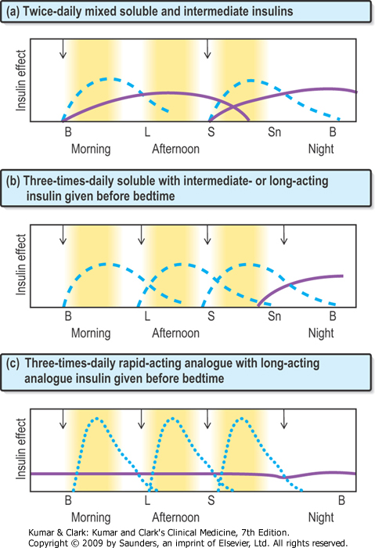

Slide 30
Other Measures
Blood pressure control –
angiotensin converting enzyme (ACE) inhibitor
angiotension II receptor (AIIR) antagonist
Statin

Slide 31
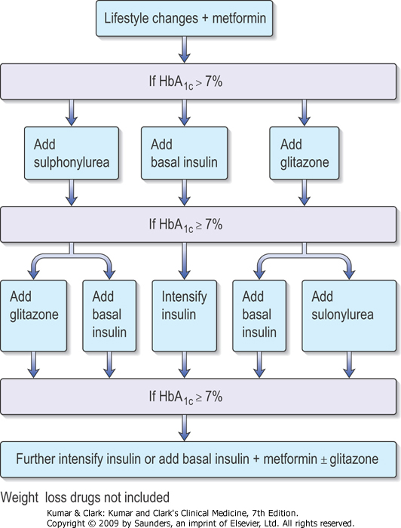

Slide 32
Monitoring DM Control
Urine Tests –
dipsticks
correlation with simultaneous blood glucose is poor
Home blood glucose tests –
FBS useful tablet-treated Type 2 DM
RBS has limited value
Glycosylated Haemoglobin (HbA_{1C}) –
normal 4 - 6.2%
average blood glucose concentration over life span of Hb molecule

